Slide 1
Machine Learning
Unit - 2

Slide 2
Accessing Classification Performance (Binary Classification)

Slide 3
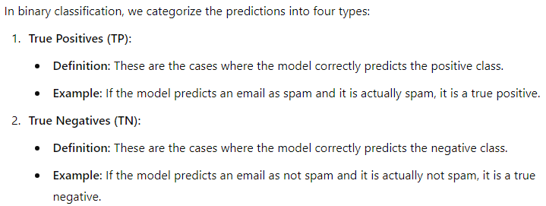
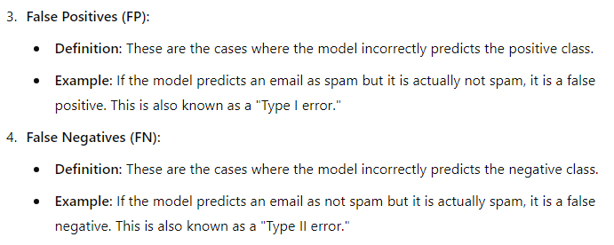
True Positives (TP), True Negatives (TN), False Positives (FP), and False Negatives (FN):-

Slide 4
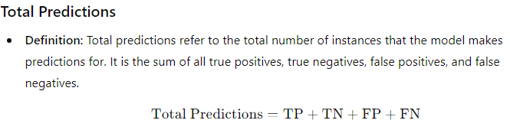
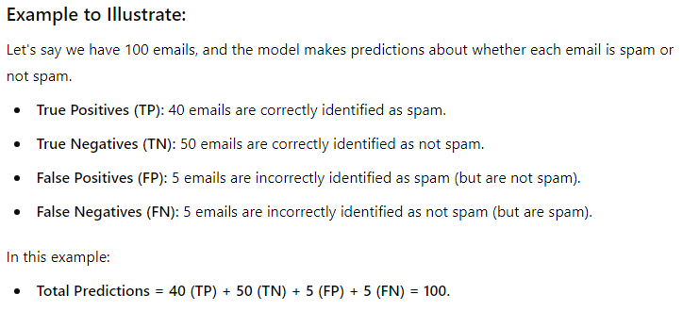

Slide 5
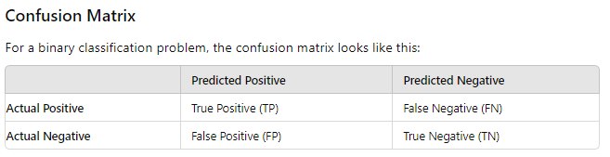
Confusion Matrix:-
A confusion matrix is a table used to evaluate the performance of a classification model by comparing the predicted classes to the actual classes. It provides a summary of prediction results and helps in understanding how well a classification model is performing. The confusion matrix is particularly useful for binary and multi-class classification problems.

Slide 6
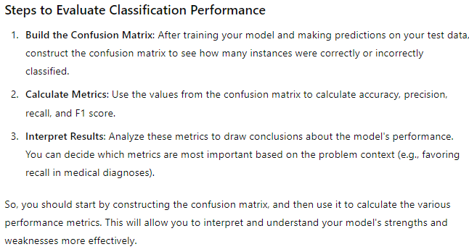

Slide 7
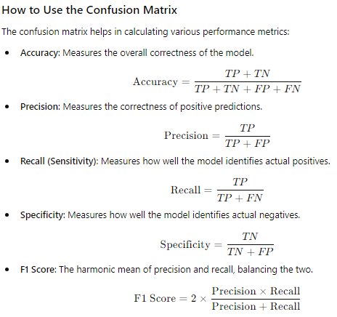

Slide 8
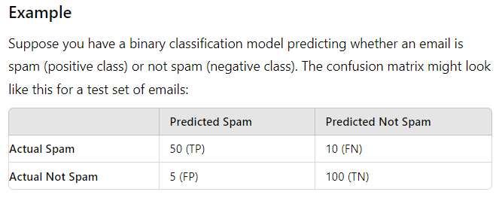
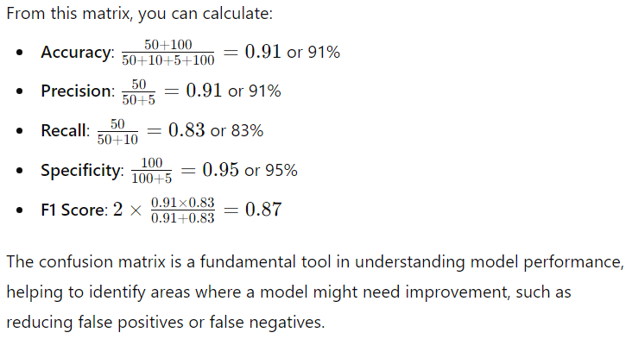

Slide 9
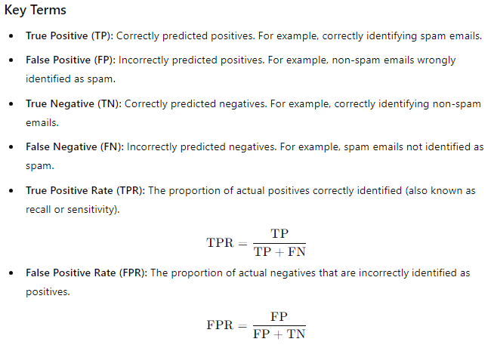
What is an ROC Curve?
The ROC (Receiver Operating Characteristic) curve is a graph that helps us understand how well a binary classification model (like a spam detector) is performing. It shows how the model's sensitivity (ability to detect true positives) compares to its false positive rate (how often it wrongly labels negatives as positives) at different thresholds.

Slide 10
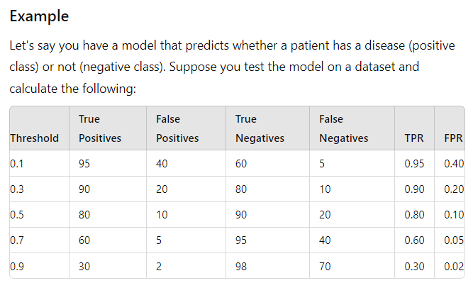
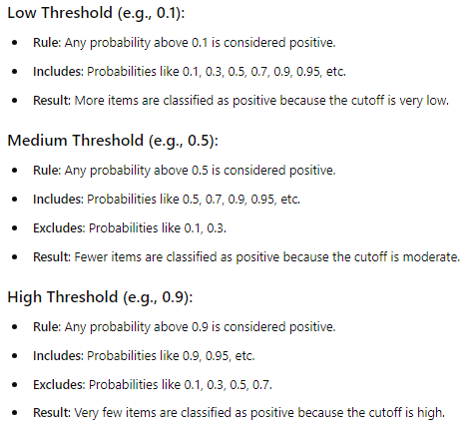
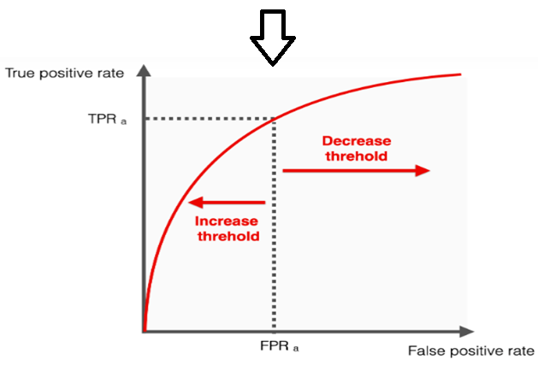
Using different thresholds helps us to explore how the model works and find the best way to classify emails based on your specific requirements. It’s about understanding and optimizing the model’s pattern of decision-making.

Slide 11
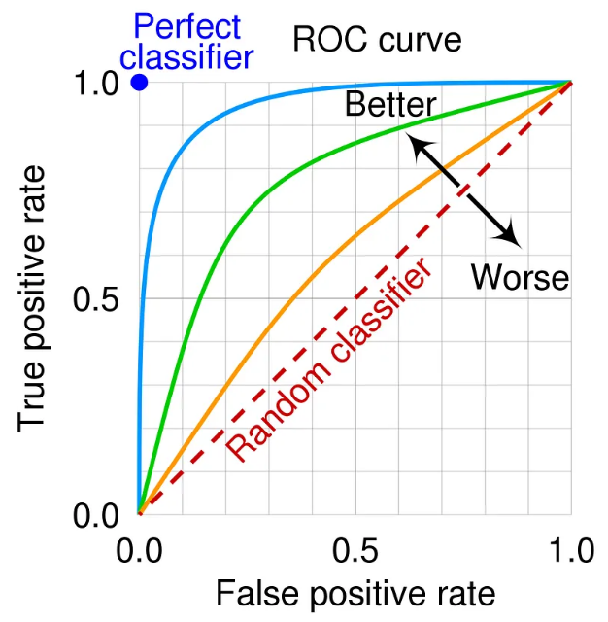
Benefits of Using an ROC Curve:-
Visualize Model Performance: The ROC curve provides a visual representation of a model's performance across all possible thresholds, allowing you to see how well it distinguishes between positive and negative classes.
Compare Models: You can use the ROC curve to compare multiple models. A model with a curve closer to the top-left corner generally has better performance.

Slide 12
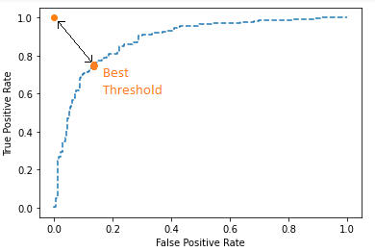
Benefits of Using an ROC Curve:-
The ROC curve helps you find the best threshold for your specific needs.
Choosing an Optimal Threshold with the ROC Curve
Visual Evaluation: By plotting the ROC curve, you can see how the model performs at different thresholds.
Trade-offs: You can visualize the trade-offs between true positive rate and specificity false positive rate.
Finding the Best Point: Look for the point on the ROC curve that is closest to the top-left corner. This point represents the best balance between sensitivity and specificity.
Optimal Threshold Example:
If 0.5 works best: Suppose the ROC curve shows that the threshold of 0.5 gives a high true positive rate with a low false positive rate. You would choose 0.5 because it provides a good balance for your model.

Slide 13
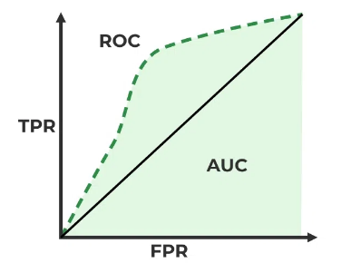
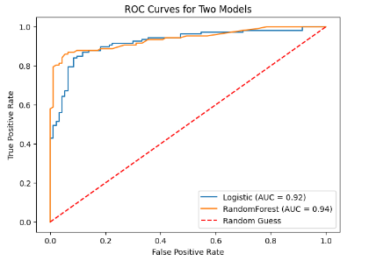
Area Under Curve (AUC) Curve:
The AUC is a single scalar value that quantifies the overall performance of the model across all possible thresholds.
It summarizes the information provided by the ROC curve into a single number, making it easier to compare different models.
Imagine a medical test designed to detect a disease:
High AUC (e.g., 0.95): Indicates that the test is very good at distinguishing between healthy and diseased patients.
Low AUC (e.g., 0.55): Suggests the test doesn't perform much better than random guessing.

Slide 14
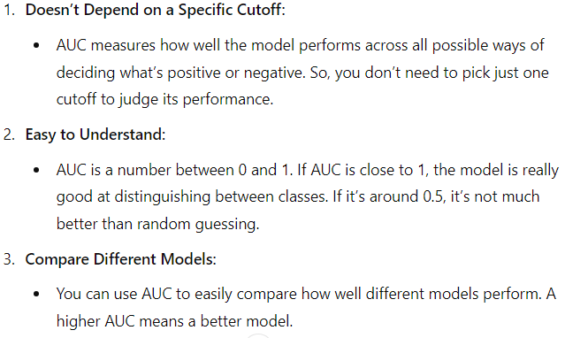
Area Under the Curve (AUC) Benefits:-

Slide 15
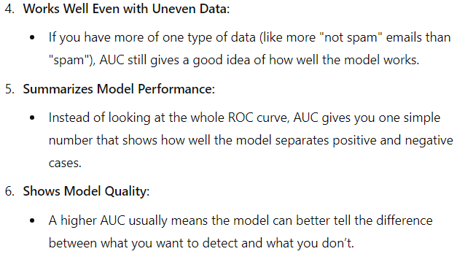
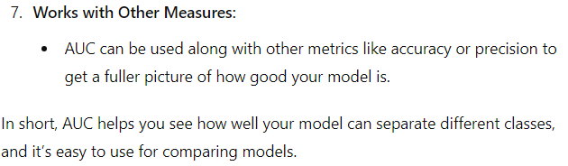
Area Under the Curve (AUC) Benefits:-

Slide 16
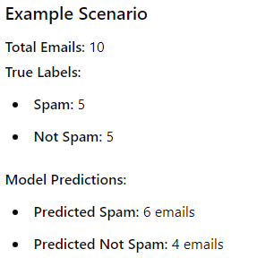
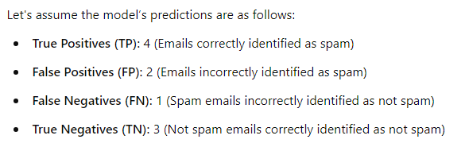

Slide 17
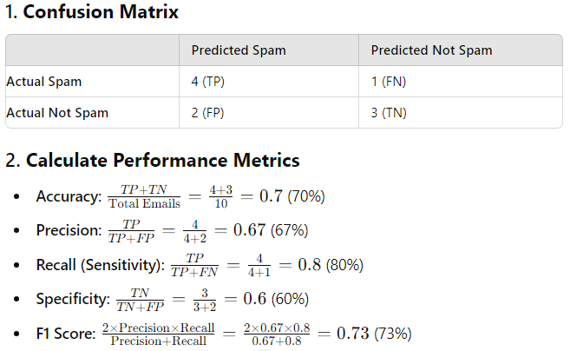

Slide 18
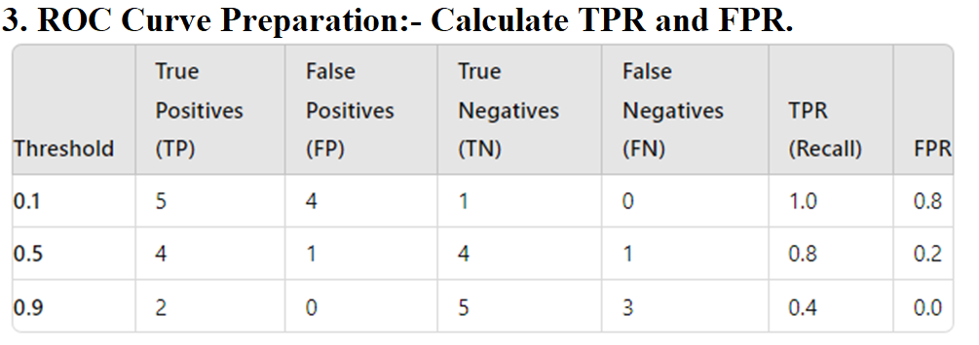
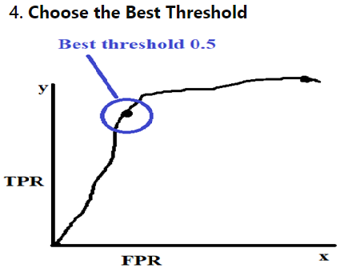

Slide 19
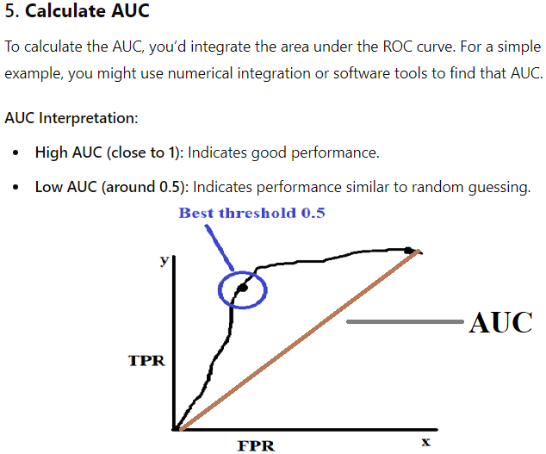

Slide 20
Accessing Classification Performance (Multiclass Classification)

Slide 21
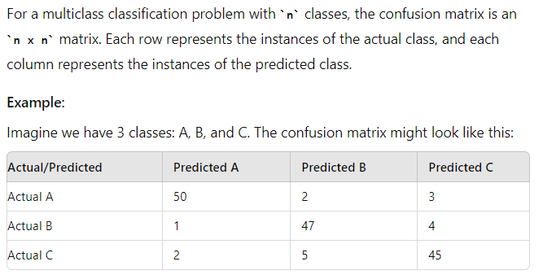
Confusion Matrix:-

Slide 22
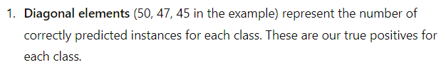
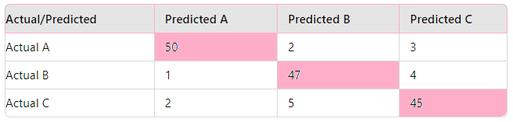

Slide 23
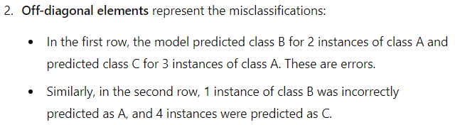
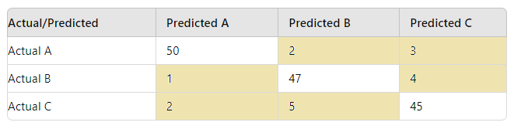

Slide 24
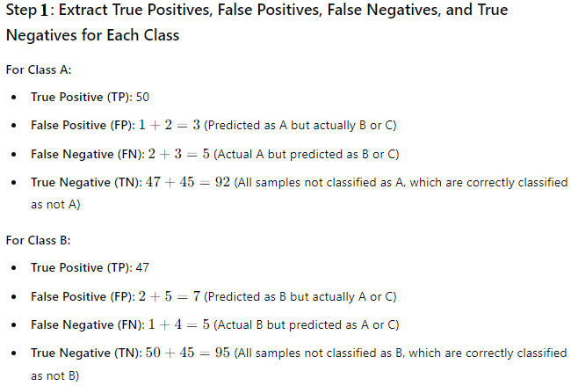
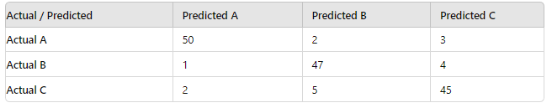

Slide 25
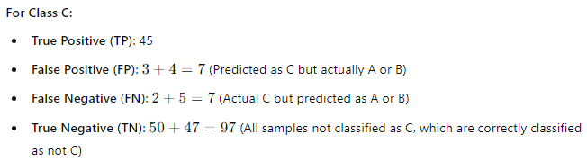

Slide 26
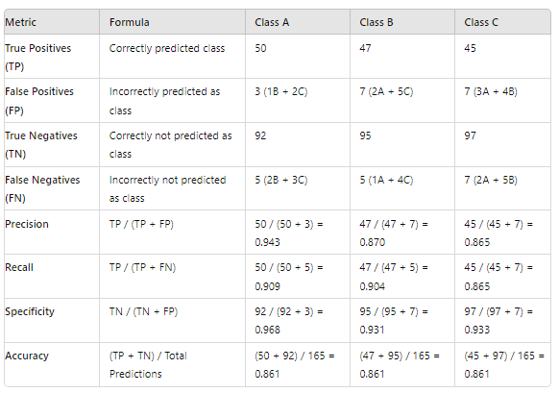
Step 2: Find Precision, Recall, Specificity and Accuracy:-

Slide 27
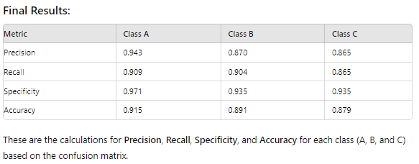
If your aim was to ensure that Precision, Recall, Specificity, and Accuracy for each class are above 80%, and in this case, all of them meet that threshold, it indicates that the model is performing well across multiple metrics.

Slide 28
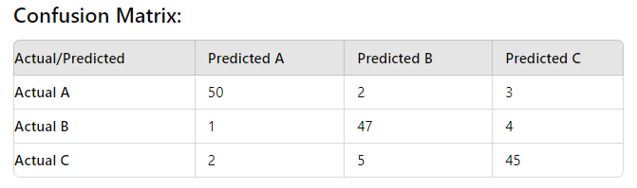
Macro-average, micro-average, and weighted average
While ROC and AUC are typically used for binary classification, for multiclass classification, calculating these metrics becomes more complex.
Instead of relying on ROC and AUC for multiclass classification, using macro-average, micro-average, and weighted-average metrics helps provide a more accurate performance evaluation. These averages aggregate the performance across all classes to verify the confusion matrix's accuracy, allowing you to handle multiclass problems effectively.
In the given confusion matrix:-

Slide 29
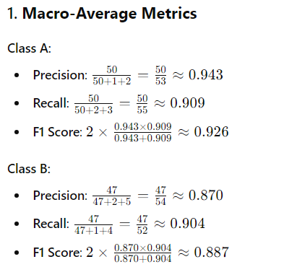
Macro-average, micro-average, and weighted average

Slide 30
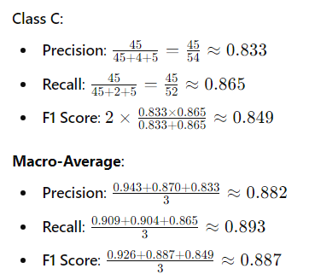
Macro-average, micro-average, and weighted average

Slide 31
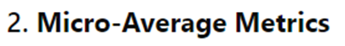
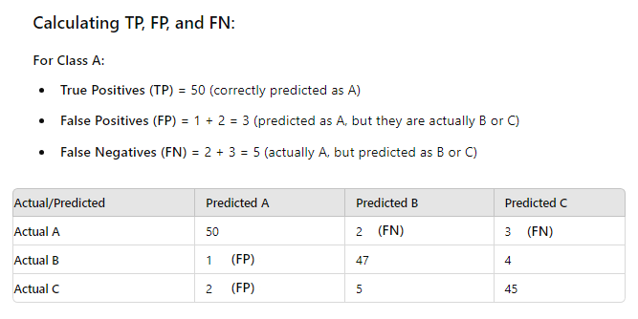
Macro-average, micro-average, and weighted average

Slide 32
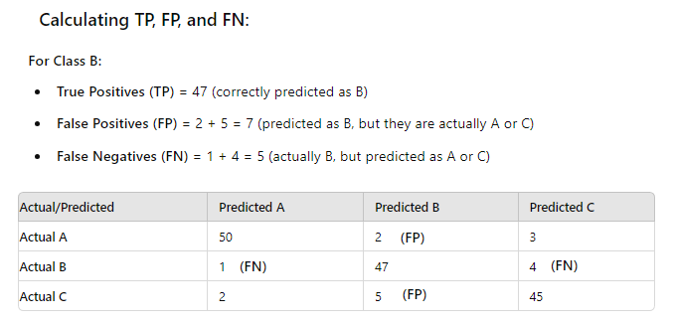

Slide 33
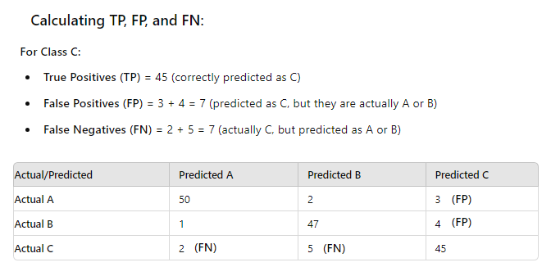

Slide 34
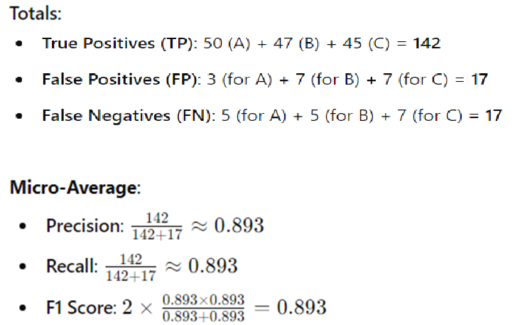

Slide 35
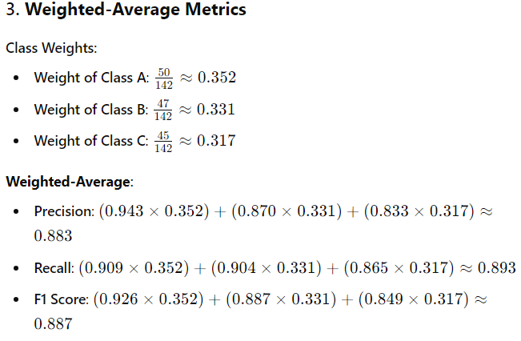
Macro-average, micro-average, and weighted average

Slide 36
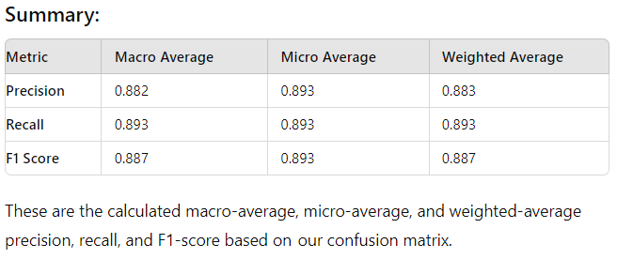
Macro-average, micro-average, and weighted average
If all these averages are above your predefined target values, it suggests that the model has a strong overall performance and the confusion matrix indicates good accuracy and reliability.
However, if any of these metrics fall below your target, it might highlight areas where the model could be improved, such as handling certain classes better or reducing false positives/negatives.

Slide 37
Accessing Class Probability Estimates

Slide 38
Class Probability Estimation:-
In class probability estimation, you will teach how to calculate the likelihood that a given data point belongs to a particular class. Here's a simple breakdown:
Class Probability Estimation: It is about predicting the probability that a data point belongs to each possible class. For example, in a binary classification, instead of just predicting "yes" or "no", the model will estimate the probability of "yes" (e.g., 0.7) and "no" (e.g., 0.3).
Logistic Regression: This is a common method for estimating probabilities in binary classification. The formula outputs values between 0 and 1, which are interpreted as probabilities.
Multiclass Classification: In multiclass classification, class probability estimation involves predicting the probability for each class. For example, if there are 3 classes, the model will predict probabilities like Class 1: 0.5, Class 2: 0.3, Class 3: 0.2.
Softmax Function: For multiclass problems, you might also teach the softmax function, which converts raw model outputs (logits) into probabilities.

Slide 39
Advantages of class probability estimation:-
Better Decisions: It tells us how sure the model is about its predictions. For example, a high probability means the model is confident.
Adjustable Thresholds: You can change how you decide which class to choose based on the probability. This is useful when different outcomes have different costs or risks.
Handling Uncertainty: Probabilities help us understand how uncertain or risky a prediction is.
Model Evaluation: Many tools and methods to check how well a model works need probabilities, not just final class labels.
Ranking: Probabilities help in ordering or ranking items, like recommending products or sorting search results based on how likely they are to be relevant.
Decision Support in Complex Systems: Class probability estimates can be used in more complex systems where decisions are not simply binary but involve multiple actions or scenarios. For instance, in medical diagnosis, probabilities can help doctors decide between various treatment options based on the likelihood of different outcomes.

Slide 40
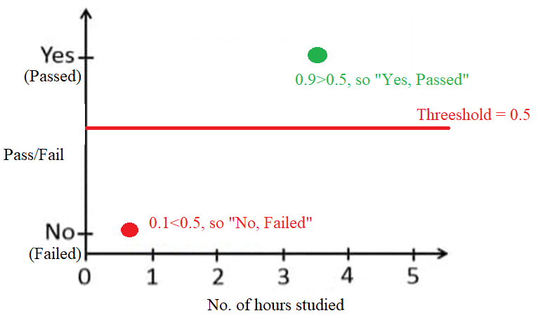
Logistic regression:-
Logistic regression is a type of model which is used to predict the probability of a binary outcome (Yes or No). If the probability calculated by the model is more than 0.5, you classify it as "yes"; if it's less than 0.5, you classify it as “no”.

Slide 41
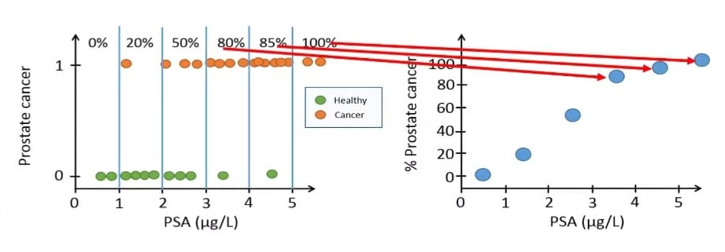
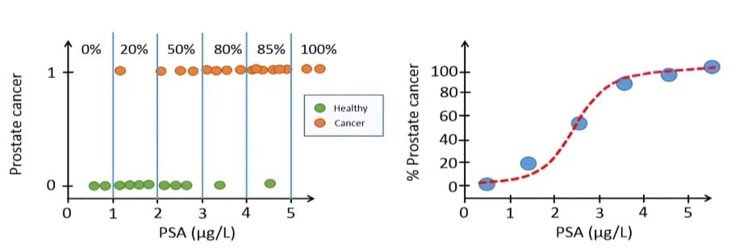
The model converts binary outcomes (1 and 0) into probabilities (0 to 100%):-

Slide 42
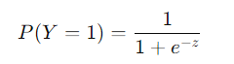

How logistic regression is used for probability estimation:-
Logistic Function: It uses a special function called the logistic (or sigmoid) function, which converts any number into a probability between 0 and 1. The formula for this function is:
Thresholding: After estimating the probability, the model decides the outcome. If the probability is greater than 0.5, it predicts "Yes" (or 1). If it's less than 0.5, it predicts "No" (or 0).
Interpretation: The output is a probability, such as 0.8, which means the model thinks there's an 80% chance that the outcome is "Yes."
This is how Logistic Regression helps estimate probabilities instead of just predicting the class directly.

Slide 43



Slide 44

How Naïve Bytes Classifier is used for class probability estimation:-

Slide 45


Slide 46


Slide 47

How Decision tree is used for class probability estimation:-

Slide 48
Types of method used in assesing class probabilities:-
Logistic Regression:-
Method: It uses the logistic function to convert the linear combination of features into a probability between 0 and 1. This is commonly used for binary classification.
How: It outputs a probability that a data point belongs to the positive class (e.g., "Yes") and classifies it based on a threshold (commonly 0.5).
Naive Bayes:-
Method: It applies Bayes' Theorem to calculate the probability of a class given the features. It assumes that all features are independent (the "naive" assumption).
How: It computes probabilities for each class based on prior probabilities and feature likelihoods, then selects the class with the highest probability.
Decision Trees:-
Method: Decision Trees estimate probabilities by calculating the proportion of class samples at each leaf node.
How: After the tree is built, each leaf node represents a probability distribution for the classes based on the frequency of the classes in that leaf.
Random Forest:-
Method: Random Forests estimate class probabilities by averaging the probabilities across multiple decision trees in the forest.
How: Each tree provides a probability estimate, and the final probability is the average of all these estimates.

Slide 49
Accessing Class Probability Estimates limitations:-
Here are some limitations or challenges of accessing class probability estimates:
Model Overconfidence: Some models, like decision trees, can produce probabilities that are too confident (close to 0 or 1) even when the data is noisy or uncertain.
Poor Calibration: Not all models provide well-calibrated probabilities. For example, models like Naive Bayes tend to assume independence between features, which can lead to inaccurate probability estimates.
Threshold Sensitivity: The choice of the probability threshold (e.g., 0.5) can affect the outcome. This threshold might need to be adjusted for different situations, which can be tricky.
Limited Interpretability: In some complex models like random forests or neural networks, understanding why the model assigns a particular probability can be difficult.
Class Imbalance: In cases where one class significantly dominates the data, the probability estimates can be biased toward the dominant class, making predictions for the minority class less reliable.
Overfitting: If a model is overfitted to the training data, the probability estimates may be unreliable for new, unseen data.
Computation Cost: Estimating probabilities, especially in large models or datasets, can be computationally expensive and slow.

Slide 50
Multiclass Classification

Slide 51

Difference between binary classification and multiclass classification:-

Slide 52
Accessing Performance of Regression-Error measures

Slide 53

The performance of regression models is commonly evaluated using error measures, which quantify the difference between the predicted values and the actual values. Here are some common regression error measures used to assess the performance of a model:

Slide 54


Slide 55





Slide 56


Example:-
We have actual and predicted weights as follows:

Slide 57




Slide 58



Slide 59



Slide 60

Difference between Confusion Matrix and Performance of Regression-Error measures :-

Slide 61
Overfitting-Catalysts for Overfitting:

Slide 62

Definition of Overfitting:-
Imagine a student who has already learned a topic but keeps studying the same material over and over again. This can be likened to overfitting in machine learning. Just as the student is focusing too much on one topic and not learning anything new, a model that overfits has learned the details and noise of the training data too well, which makes it less effective at handling new, unseen data. Just as it's important for a student to learn a variety of topics to be well-rounded, it's crucial for a model to generalize well rather than just fitting the training data perfectly.

Slide 63

Definition of Overfitting:-

Slide 64

Catalysts for Overfitting:-

Slide 65
Case Study of Polynomial Regression:-

Slide 66

Polynomial Regression:-

Slide 67

Polynomial Regression:-

Slide 68


Polynomial Regression:-

Slide 69


Polynomial Regression:-

Slide 70

Polynomial Regression:-

Slide 71


Polynomial Regression:-

Slide 72


Polynomial Regression:-
Let’s access the performance of regression:

Slide 73



Slide 74



Slide 75
Theory of Generalization

Slide 76
What is Generalization? Generalization is about making sure that when you learn something (like solving a math problem), you can use that knowledge to solve new problems you haven't seen before. In machine learning, it's making sure the model can handle new data, not just the data it was trained on.
Training Data vs. New Data: Think of training data like practice exercises for a test. Generalization is about how well you can answer new test questions (new data) based on your practice.
Overfitting: This is like memorizing the answers to practice questions without understanding the material. You might do well on those specific questions but struggle with different ones. In machine learning, overfitting means the model does too well on the training data but poorly on new data.
Underfitting: This is like not studying enough and not understanding the material well. You’ll do poorly on both practice questions and new questions. In machine learning, underfitting means the model is too simple to learn from the training data effectively.
Finding the Right Balance: Just like in studying, you need to find a balance. You want to learn enough to do well on both practice and new questions. For machine learning, this means creating a model that's good at both the training data and new data.
Regularization: This is like using study guides to avoid memorizing and instead focus on understanding. This is like setting rules to make sure you don’t just memorize but understand the material. It helps keep the model from focusing too much on details that don’t matter. Regularization in machine learning helps prevent overfitting by making the model simpler and less likely to memorize details from the training data
.
Cross-Validation: This is like taking practice tests with different sets of questions to see how well you’re learning. In machine learning, it’s about testing the model on different parts of the data to see how well it generalizes.

Slide 77
Effective Number of Hypotheses:-
Hypothesis in Machine Learning:-
Hypothesis: Imagine the model is trying to figure out how the size of a house (in square feet) relates to its price. The hypothesis could be something like, "For every extra square foot, the price increases by a certain amount." The model is trying to guess this rule.
Learning Process: The model looks at data from houses that have already been sold. It sees that a 1,000 sq ft house sold for $200,000, a 1,500 sq ft house sold for $300,000, and so on. It starts by guessing a simple rule, like "Every extra square foot adds $200 to the price." If this guess isn’t accurate, the model adjusts it slightly and tries again, over and over, to improve its guess.
Goal: The model’s goal is to be able to predict the price of a house it hasn’t seen before, based on its size. For example, if it sees a 2,000 sq ft house, it should be able to predict its price accurately.
Cost Function: After making a guess, the model checks how far off it was from the actual prices in the data. If it predicted $250,000 but the real price was $300,000, the cost function would tell the model it was off by $50,000. The model uses this feedback to make better guesses in the future.

Slide 78

Effective Number of Hypotheses:-
Hypothesis Space (H):-
Hypothesis space is the set of all the possible legal hypothesis. This is the set from which the machine learning algorithm would determine the best possible (only one) which would best describe the target function or the outputs.

Slide 79

Effective Number of Hypotheses:-

Slide 80

Effective Number of Hypotheses:-

Slide 81

Effective Number of Hypotheses:-

Slide 82


Effective Number of Hypotheses:-

Slide 83

Effective Number of Hypotheses:-
Evaluating Hypotheses:-

Slide 84

Effective Number of Hypotheses:-
Generalization:
Trying on New Data: Once you’ve selected the best-performing rule based on your metrics, you need to test it with new data it hasn’t seen before. This checks if the rule generalizes well.
Overfitting: If the rule performs well on the training data but poorly on new data, it’s overfitting. The model is too tailored to the training data and doesn’t work well with new information.
Good Generalization: If the rule performs well on both training and new data, it means the model is good at generalizing and can be trusted.
Improving the Model:
Tweaking the Model: To make the model even better, you may need to adjust things:
Changing Settings: Modify how the model operates.
Adding Features: Include more information or details that might help improve predictions.
Trying Different Models: Experiment with different models to find the best one.

Slide 85


Effective Number of Hypotheses:-
Now, coming to Effective Number of Hypotheses:-

Slide 86



Slide 87



Slide 88


Slide 89
The effective number of hypotheses can depend on the threshold you set for determining what counts as a "good" model. Here’s how it works:
Understanding Thresholds:
Threshold: This is a criterion or a set of criteria you decide on to judge whether a model is "good" or "effective."
For example, you might decide that a model must have:
An accuracy of at least 80%.
An RMSE below a certain value.
A precision above 70%, etc.
How It Affects the Effective Number of Hypotheses:
Scenario: You have 5 models.
Threshold: You set a threshold (e.g., a model must have an accuracy above 80% and RMSE below a specific value).
Evaluation: After applying these thresholds, you find that 3 models meet your criteria.
Result:
The effective number of hypotheses would be 3 because that’s how many models passed your threshold.
If you changed your threshold (e.g., required even higher accuracy), you might have fewer models that qualify as "good." In that case, the effective number of hypotheses would decrease.

Slide 90


Bounding the growth function:-

Slide 91

Bounding the growth function:-

Slide 92


VC Dimension:-

Slide 93




VC Dimension:-

Slide 94

VC Dimension:-

Slide 95



Slide 96


Slide 97


Lets see in three points:-

Slide 98


Slide 99



Now, if we will try to shatter in 4 points with a line, it’s not possible;

Slide 100


Vapnik-Chervonenkis Dimension:-
Simplified Explanation: VC Dimension is a way of measuring how powerful a model is. If a model can handle and correctly separate a large number of points in any possible arrangement, it has a high VC Dimension, meaning it’s very flexible. If it can only do this for a few points, it has a lower VC Dimension, meaning it’s simpler and less flexible.

Slide 101



Vapnik-Chervonenkis Dimension:-
Now, let’s come to Axis-Aligned Rectangle:-

Slide 102


Slide 103

How VC Dimension is connected to generalization:-
Balancing VC Dimension for Better Generalization:
The goal is to find a balance in VC Dimension that allows the model to be complex enough to capture the important patterns (not underfitting) but not so complex that it overfits the data.

Slide 104

Regularization:-

Slide 105


Regularization:-

Slide 106


Regularization:-

Slide 107


Regularization:-

Slide 108


Regularization:-
In this example, Ridge Regression reduces the cost function by balancing the prediction error (SSE) and the regularization penalty. The model with a weight of 4 has a lower total cost compared to the model with a weight of 5, demonstrating the benefit of regularization in reducing the overall cost.
Benefits of reducing the cost:-

Slide 109


Regularization:-
Now, lets come to Lasso Regression:-

Slide 110


Regularization:-

Slide 111

Regularization:-

Slide 112


Regularization:-

Slide 113

Regularization (Lasso Example):-

Slide 114

Regularization (Ridge Example):-

Slide 115



Key differences between LASSO and Ridge Regression:-

